Slide 1

COMPANY PROFILE
Our Philosophy
To lead the way in travel management by earning the world's trust through unwavering integrity, pioneering innovation that transforms travel experiences, and championing sustainability for a brighter, eco-conscious future.
Our Mission
Our Vision
Our Goals
Our mission is to provide exceptional travel management services that empower our clients to explore the world with confidence.
Embracing change, fostering innovation, and infectiously driving results to shape the future.
Trusted Innovative Sustainable

Slide 2
Who we are and what we do
We provide complete and dedicated travel management support for all the marine and corporate sectors Our experienced team operates 24/7/365 offering specialized fares – Marine Fares Lowest cancellation charges, minimum or nil date change charges for the marine tickets Headquartered in India with highly experienced team specialised in Marine travel We understand the difference between travel & marine travel from our years of experience in this specific field

Slide 3
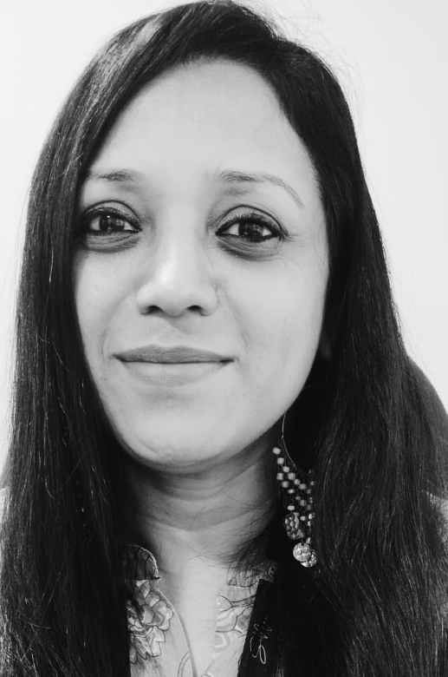

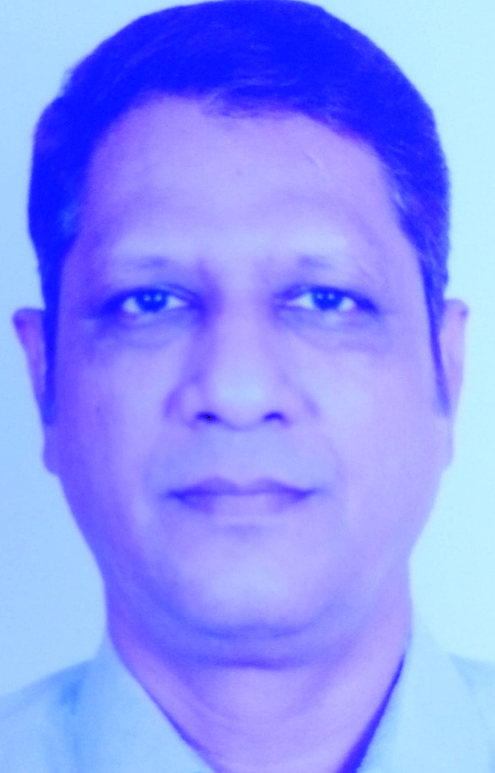

Travel team
Nandhini Veeraraghavan – Travel Director
Nandhini has 8+ yrs experience working with V.Group and was an elite member of the aviation industry for over 12 years.
Kannan Ramachandran – Travel Coordinator
Kannan has experience working in the travel industry spanning over 20+ yrs with Cox and Kings, Photon, Wabag and Techfront.
Anjum Khan – Travel Manager
Anjum has 30+ yrs experience in the travel industry and was heading V.Travel (V.Group) for over 12 yrs.
Sunny Bhuwad – Travel Coordinator
Sunny has an experience working in the travel industry for over 12yrs with Interglobe, WNS and ATPI.

Slide 4







Our service partners

Slide 5
Our Credentials:
Catering to over 100 vessels 20+ clients globally Worldwide ticketing with easy access on email and smartpal Multiple office locations Available 24/7/365 Holding our own IATA license Marine fares offering special fares and other benefits – 2 piece baggage/ low cancellation charge/multiple free date change Fixed service fee per ticket

Slide 6



Extra Baggage Allowance
Advantages of Marine fares:
One way special fares
Multiple change options

Slide 7
Thank You

